Slide 1

K. L. E. Dr. M. S. SHESHGIRI COLLEGE OF ENGINEERING AND TECHNOLOGY
Department of Electronics & Communication Engineering
TOPIC: “DESIGN OF AN 8X8 BIT SRAM ARRAY WITH ROW DECODER FOR LOW POWER APPLICATIONS”
BY
1 | SUDEEP ASUNDI | USN: 2KL20EC109
2 | RUMAN M MUDENUR | USN: 2KL20EC112
3 | SRUSHTI SHAHAJANAVAR | USN: 2KL20EC110
4 | SAMANTHA LOBO | USN: 2KL20EC073
UNDER THE GUIDANCE OF
Prof. NIRANJAN MUCHANDI

Slide 2
ABSTRACT
The project aims to implement a 6T SRAM cell optimized for reduced read and write times, delays, and power consumption, followed by the design of 8 X 8 arrays. It outlines the design principles, peripheral building blocks, and functionalities of SRAM at the 180nm technology node, employing Cadence Virtuoso design tool for schematic diagrams and IC design.

Slide 3
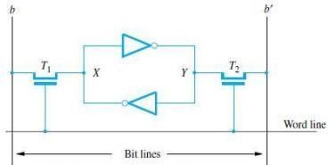
INTRODUCTION
Static Random-Access Memory (SRAM) is an integral part of modern digital systems, serving as a vital component in various applications ranging from microcontrollers to high- performance processors.
As technology advances and power efficiency becomes a top priority, the development of low-power SRAM arrays is crucial.
In this project, we propose the design of an 8x8 Bit SRAM Array with an efficient row decoder tailored for low-power applications.
Fig 1: A Static RAM Cell

Slide 4
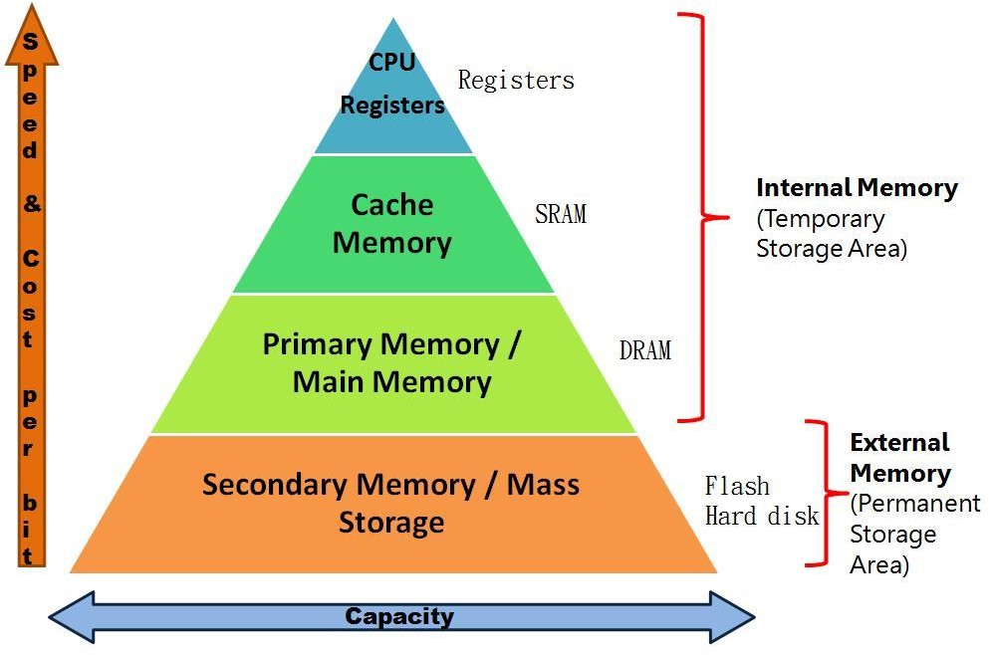
Why SRAM?
Fig 2: Comparison of speed and cost/ bit
Cache memory is used to speed up the system performance. The size of Cache memory is very less compared to Main memory, but Cache is high speed semiconductor memory, mostly comprised of SRAM.
This is the main motivation to design SRAM cell.

Slide 5
Table 1: Comparison of Memories
Characteristics | SRAM | DRAM | Magnetic Disk
Speed | Very Fast | Slower | Much slower than DRAM
Size | Large | Small | Small
Cost | Expensive | Less Expensive | Low Price

Slide 6
LITERATURE SURVEY
Reference Paper | Objective | Outcomes
[1] | Design Principles of SRAM Memory in Nano-CMOS Technologies | The design principles of SRAM including the peripheral circuitry, operations, challenges, mitigation techniques, how to improve the stability were clearly explained
[2] | Stable Local Bit-Line 6 T SRAM Architecture Design | The low-voltage pre-charged circuit which they have designed, has reduced the read error and improved the read stability and RSNM of the memory cells.
[3] | Low Power SRAM Design with Reduced Read/Write Time | Higher cell ratios can decrease the read and write time and improve stability.
[4] | A Survey on low power comparison in SRAM cell | Power SRAM cells have been categorized as 6T, 8T which increases the functionality of the circuit and it has high stability in read operation and ability in write operation.

Slide 7
PROBLEM STATEMENT (IDENTIFICATION)
In contemporary electronic systems, the demand for low-power and energy-efficient memory solutions is ever-increasing, driven by the proliferation of battery-powered devices and the need for sustainable energy consumption. This project aims to address the challenge of designing an 8x8 bit SRAM array with an efficient row decoder that caters specifically to low-power applications.

Slide 8
OBJECTIVES
The key problems to be addressed include:
Power Efficiency
Bit-Cell Architecture Selection
Row Decoder Optimization
Low-Power Modes and Dynamic Power Management

Slide 9
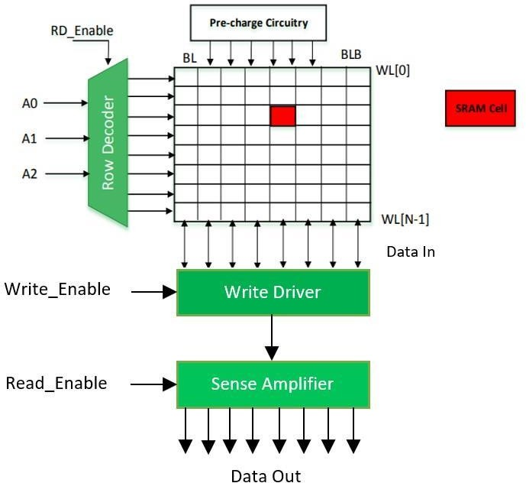
SRAM ARCHITECTURE
Fig 3: SRAM Architecture
These are the components which comprise the SRAM Architecture:
SRAM Memory Cell
Pre-Charged Circuitry
Sense Amplifier
Row Decoder
Write Driver

Slide 10
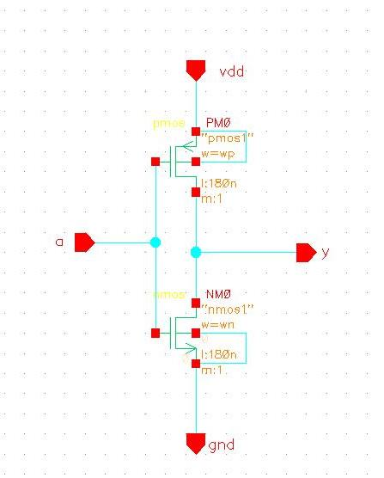
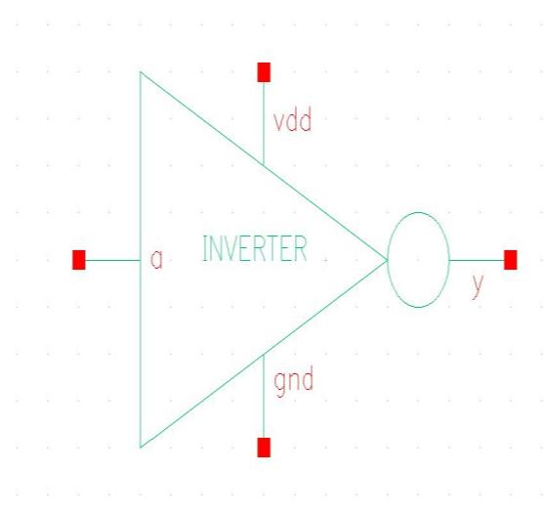
DESIGN OF SRAM CELL
Designing of basic gates while choosing aspect ratios
The first and foremost step involved in the design of SRAM Cell includes the design of
all the constituents of the standard SRAM Architecture. Hence, we designed – inverter, 4-
input NAND Gate, and 3:8 Decoder circuit. But before designing them we made sure that
the aspect ratios (Wp- PMOS channel width and Wn - NMOS channel width) are set in
such a way that we get the minimum rising and falling delays after simulation.
Inverter
Fig. 4. Inverter Schematic
Fig. 5. Inverter Symbol

Slide 11
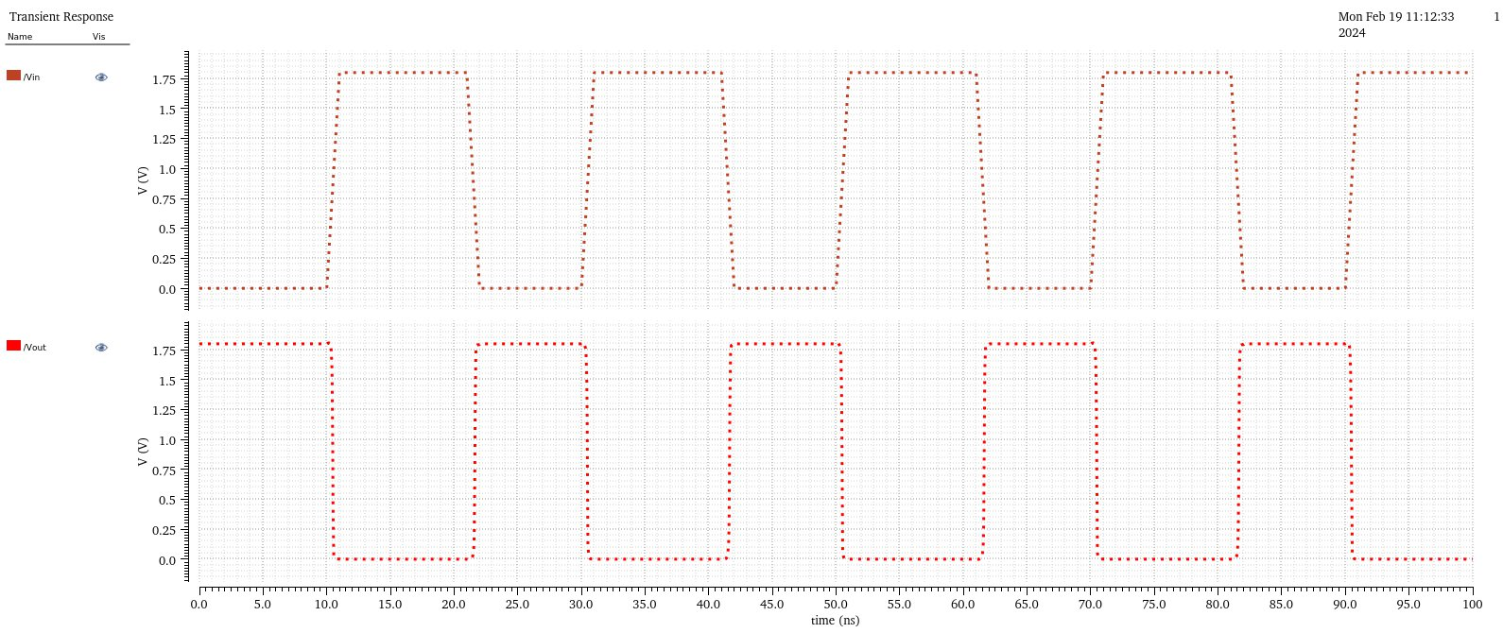
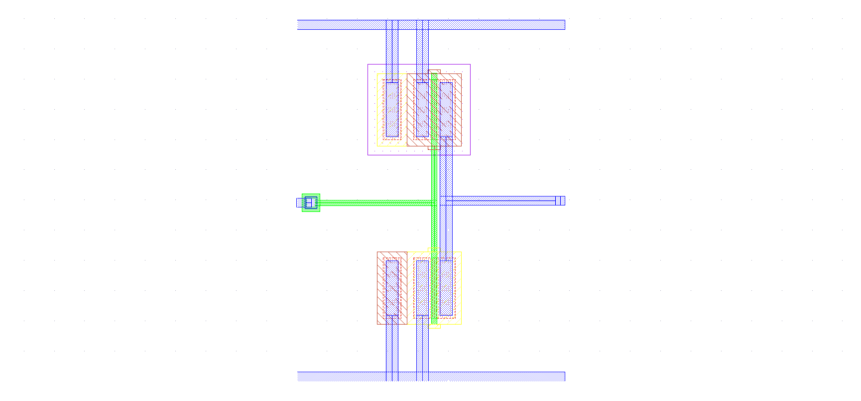
Transient analysis
Fig. 6
Designed layout
Fig. 7 Inverter Layout

Slide 12
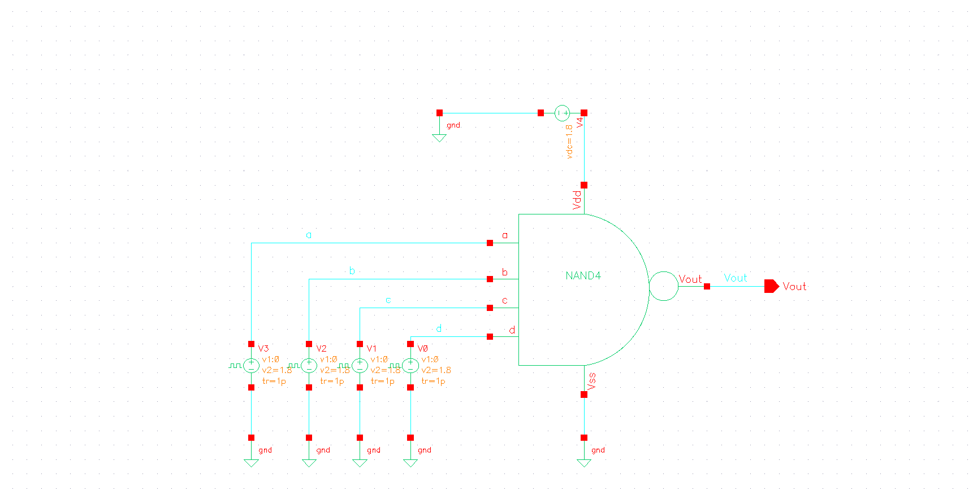
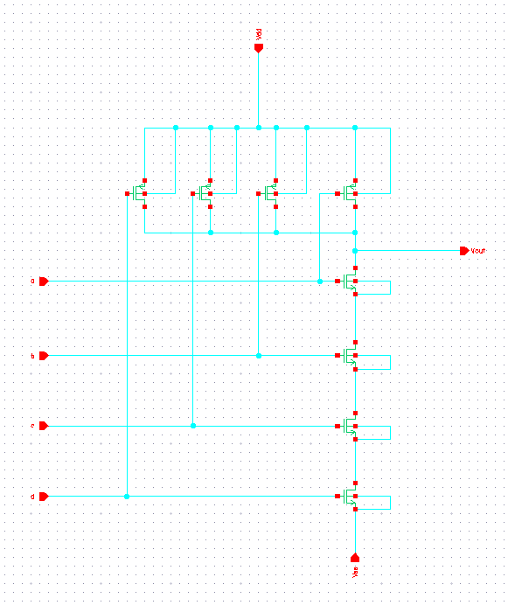
4 input NAND gate
Fig. 8.Schematic
Fig. 9. Test circuit
The four-input NAND gate is built from four transistors. The output of the device is low
(logic 0) when all the inputs (A, B, C, D) are high (logic 1), by driving the current to
ground. In the similar way, output of the device goes logically high, when all the inputs are
given logic 0 input.

Slide 13
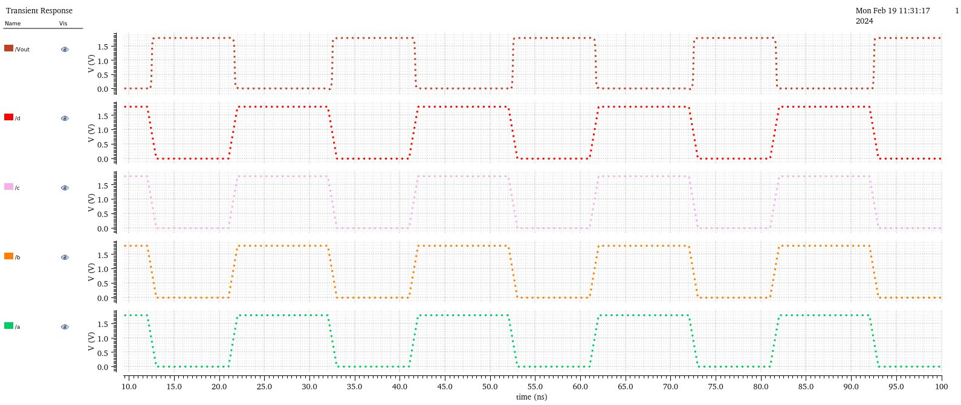
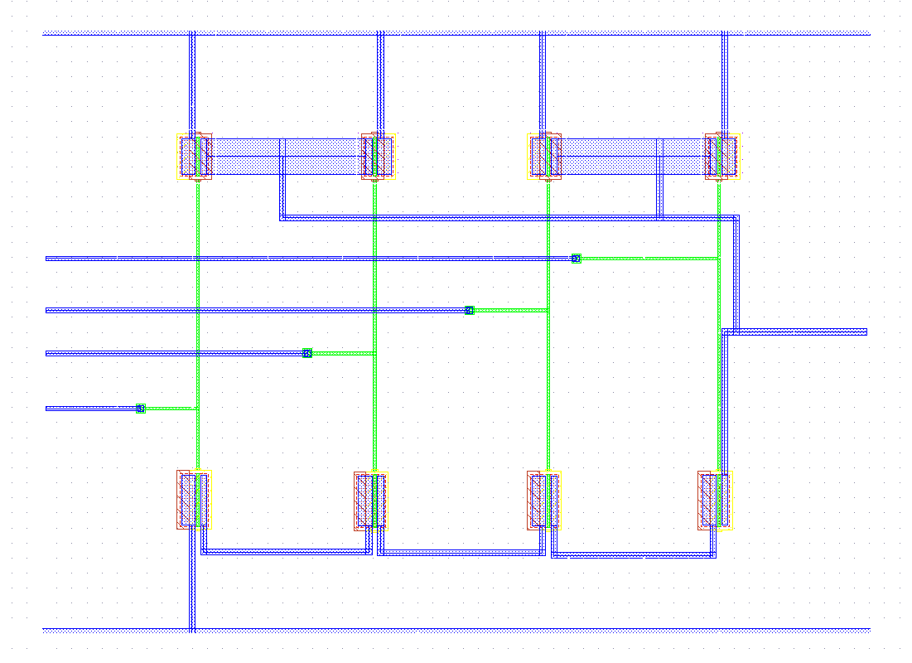
Transient analysis
Fig. 10
Designed layout
Fig. 11. Nand layout

Slide 14
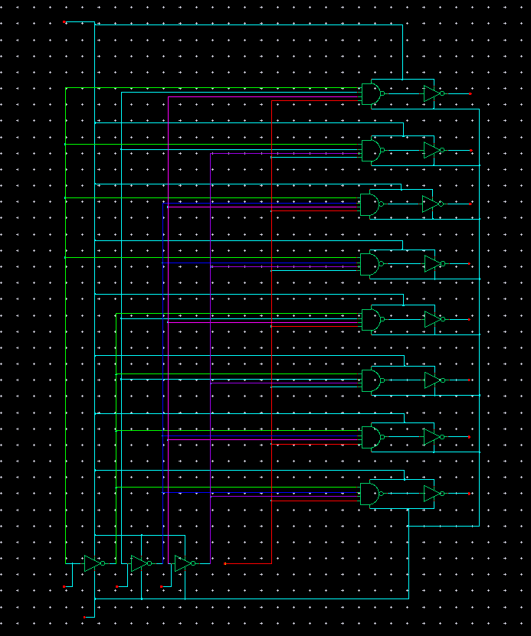
3:8 Decoder
Fig.12. 3:8 Decoder Schematic

Slide 15
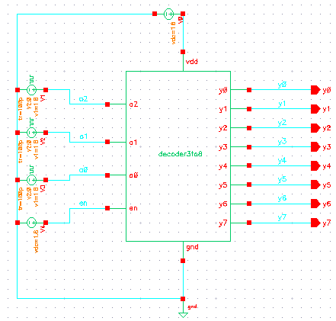
Fig. 12\3. 3:8 Decoder Test Circuit
The decoders make the number of interconnects to be quantified to a factor of log2N where N
is the number of independent address locations. In order words, they help in reducing the
total number of pins such that if there are N + K address lines then the bit storage will be
2N+K bits. Thus, supposing we have three address bits (input pins) A0, A1, A2 as shown
in our SRAM block design in figure 2; then N+K=3 therefore memory address space is 23 = 8
bits (1byte) wide.

Slide 16
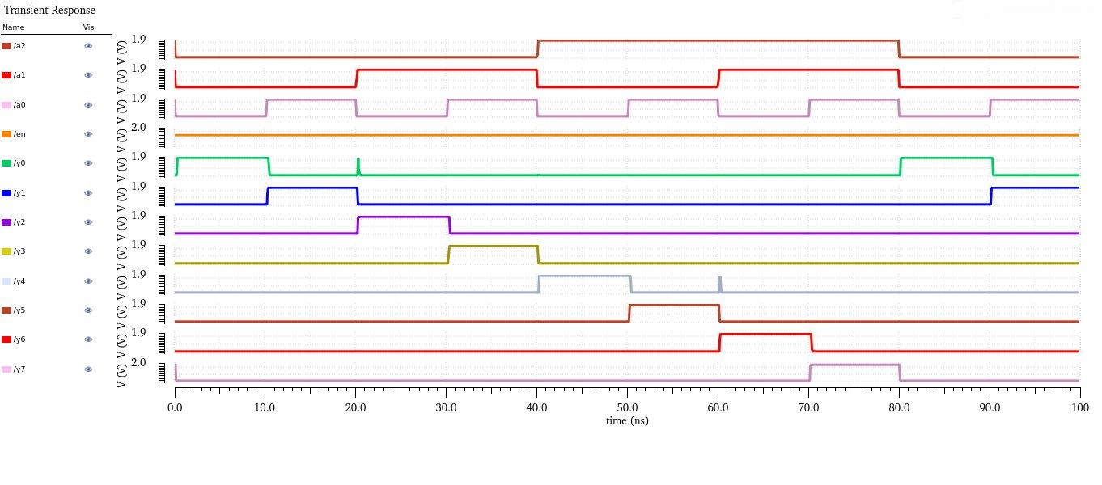
Waveform
Fig. 14. 3:8 Decoder Waveform
The Waveform for the 3 – input NAND gate is shown above and all the combinations can be
seen clearly; where the outputs are given by y7, y6, y5, y4, y3, y2, y1, and y0.

Slide 17
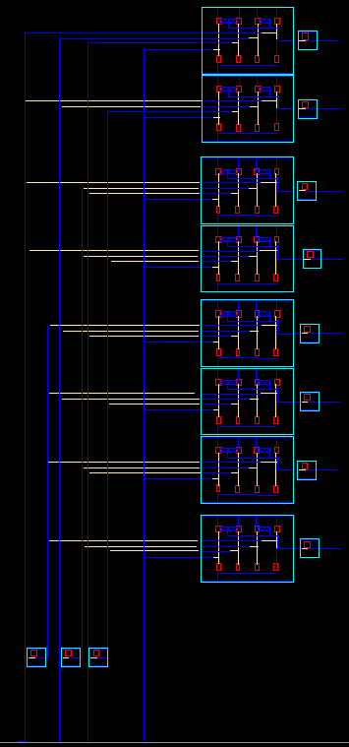
Table 2. Decoder Three-to-Eight and output selection
Inputs |  |  | Output Selection WL/ WE (As selection)
A | B | C
0 | 0 | 0 | X0
0 | 0 | 1 | X1
0 | 1 | 0 | X2
0 | 1 | 1 | X3
1 | 0 | 0 | X4
1 | 0 | 1 | X5
1 | 1 | 0 | X6
1 | 1 | 1 | X7
Fig. 15. 3:8 Decoder Layout

Slide 18
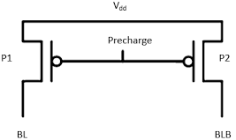
Pre-Charge Circuitry
The pre-charge circuitry is used for charging the bit lines to VDD prior a read operation. It is necessary for both bit lines (BL and BLB) to be exactly at VDD and perfectly equalized for a correct read operation. Thus, the circuit is made up of two PMOS transistors, P1 and P2.
The P1 is the equalization transistor which ensures that asymmetric defect is eliminated for correct read operation than if it was not included; in other words it helps to minimize the voltage difference between the bit lines, reduce pre-charge time by making sure that the bit lines (BL and BLB) are at nearly at equal potential.
P2 is the load transistors that connect the bit lines to the VDD for the pull up.
Fig. 16. A conventional Pre-charge Circuit

Slide 19
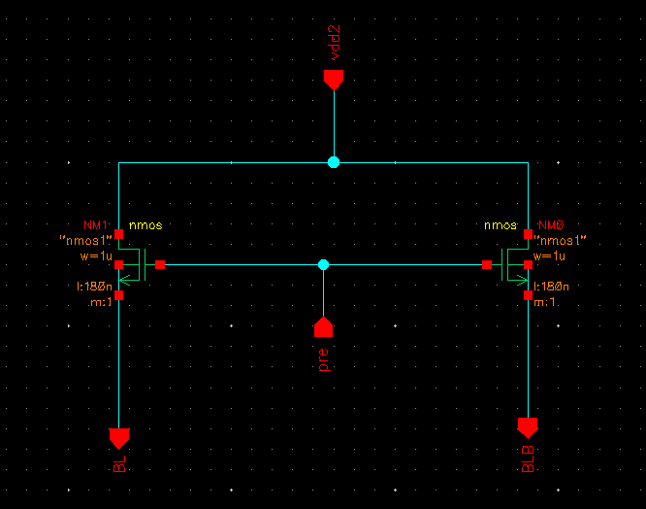
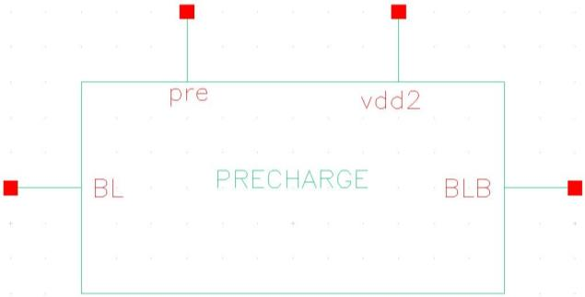
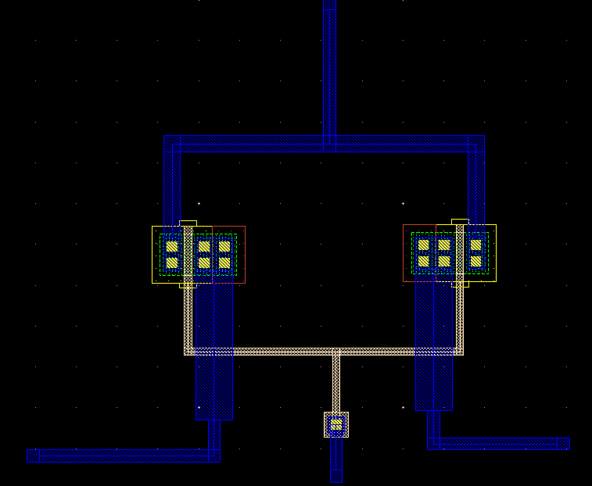
Fig. 17. Pre-charge circuit Schematic
Fig. 18. Pre-charge circuit Symbol
Fig. 19. Pre-charge circuit Layout

Slide 20
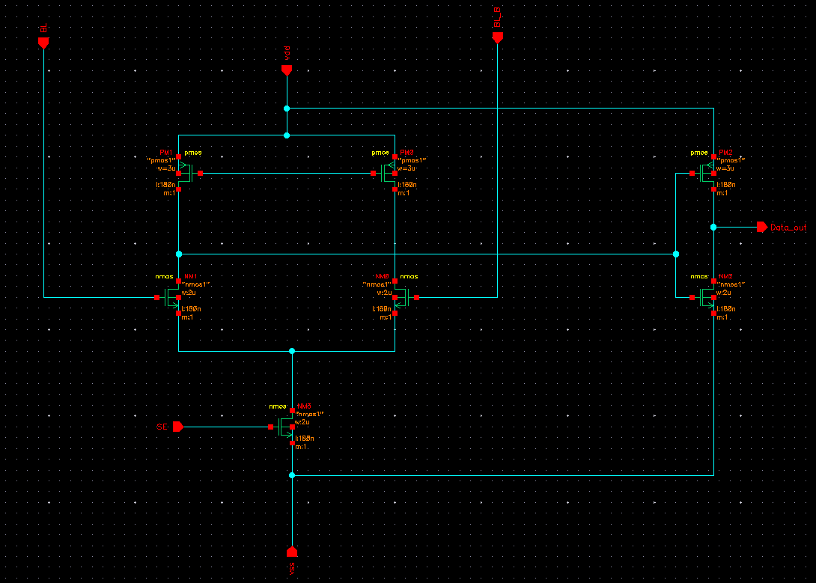
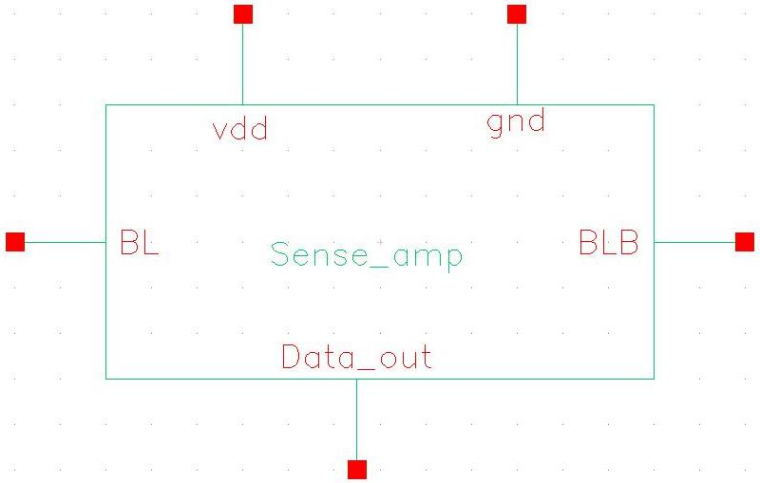
Sense Amplifier
The sense amplifier detects a small differential voltage difference in the bit lines during read cycle then it amplifies it to full swing close to the VDD thereby reducing the time required for read operation, in order words, the read operation is very fast. Because SRAM does not require constant refreshing as DRAM, hence sensing must be non-destructive unlike the destructive sensing of the DRAM cell.
Fig. 20. Sense Amplifier Schematic
Fig. 21. Sense Amplifier Symbol

Slide 21
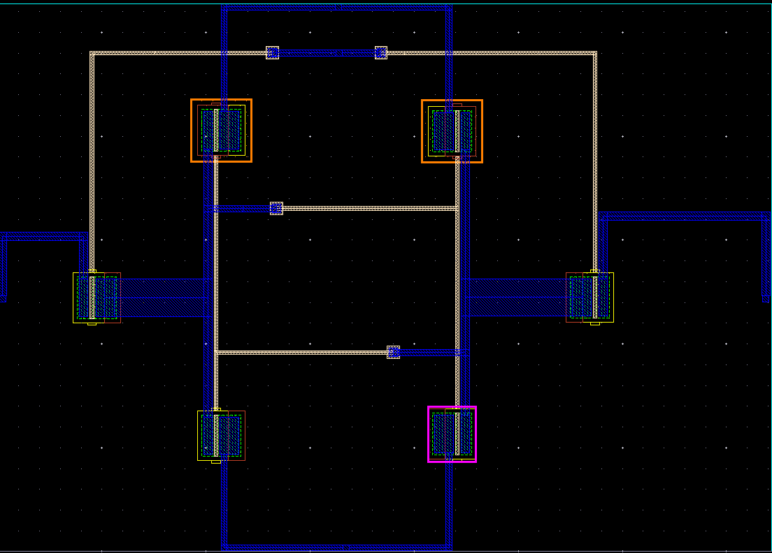
Fig. 22. Sense Amplifier Layout

Slide 22
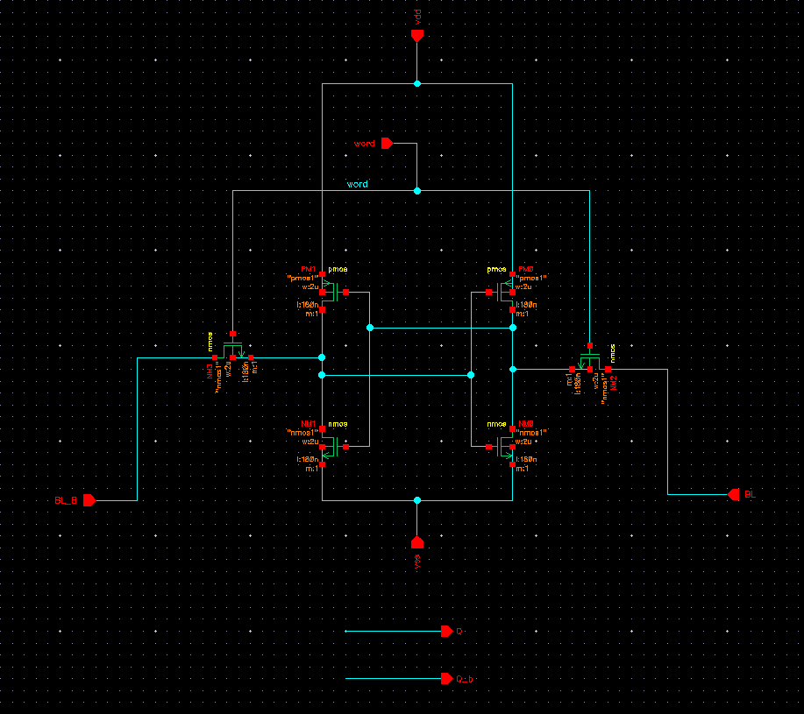
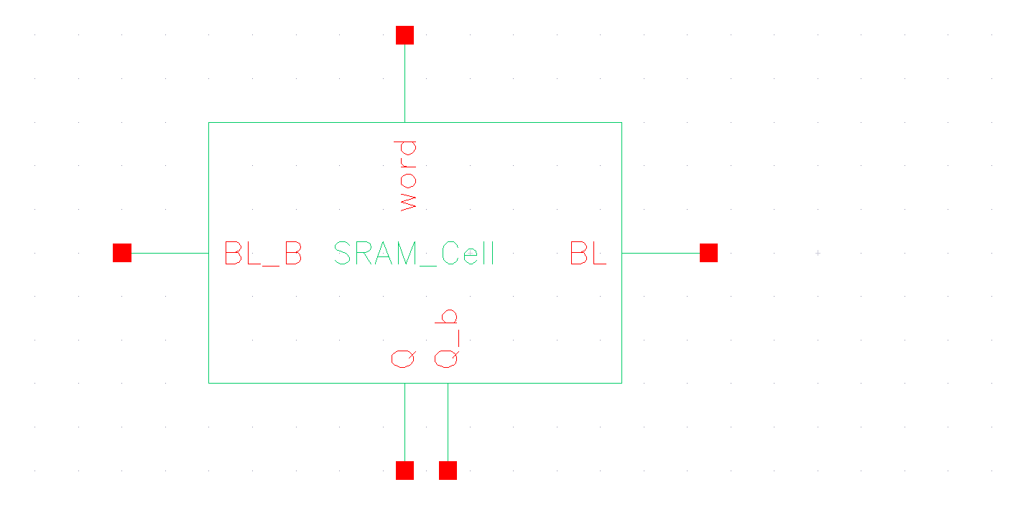
SRAM Cell
SRAM cell has three states of operation
Ideal
Reading
Writing
Fig. 24. SRAM cell schematic
Fig. 25. SRAM cell symbol

Slide 23
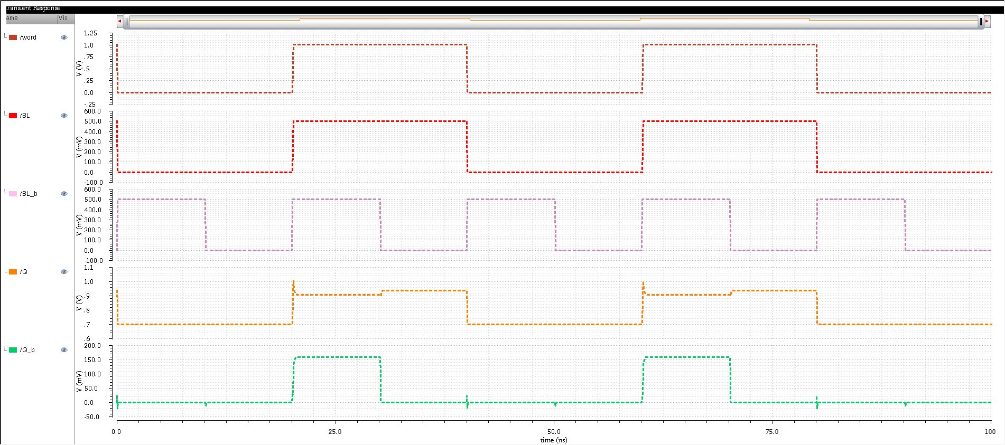
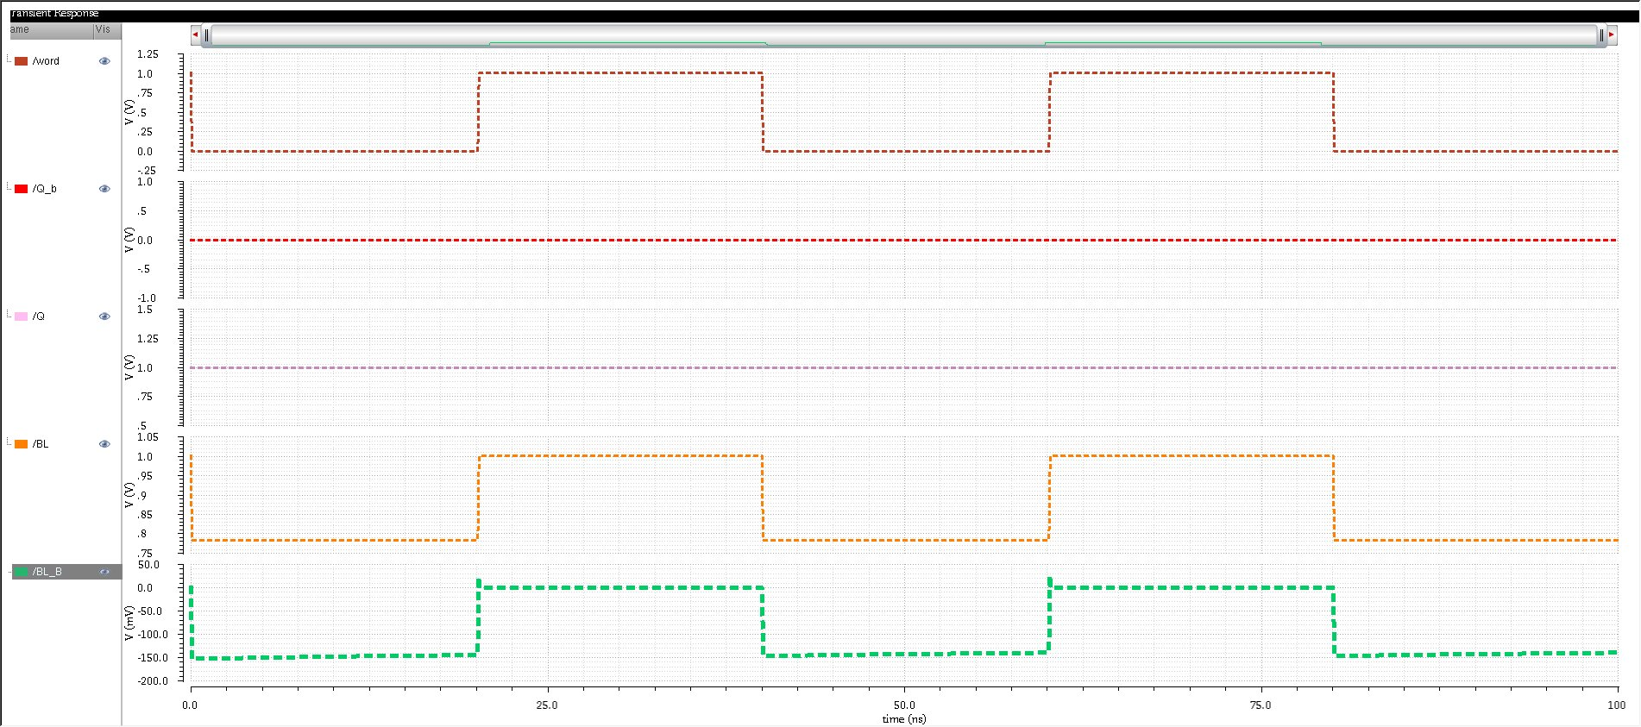
Simulation
Fig. 26. SRAM write test simulation
Fig. 27. SRAM read test simulation

Slide 24
Fig. 28. SRAM Layout

Slide 25
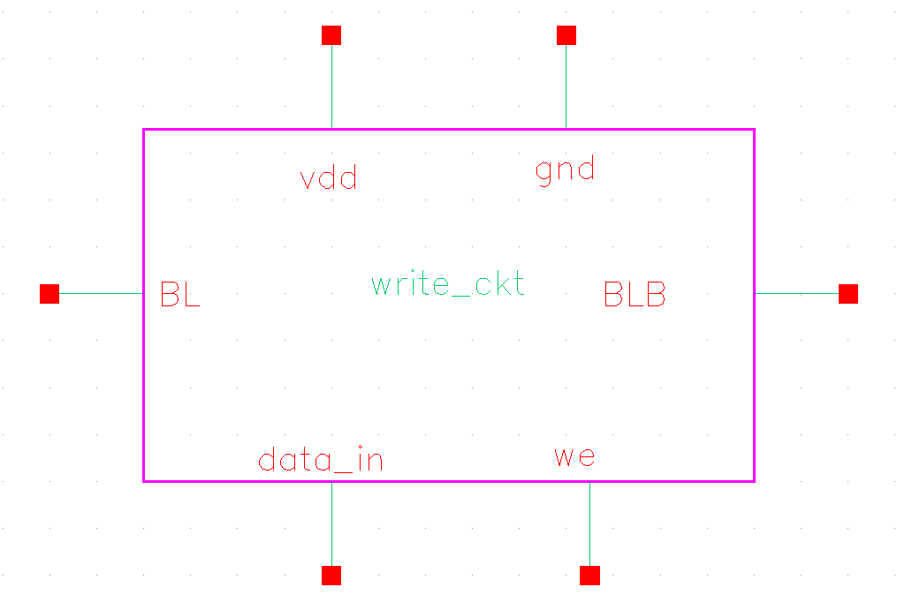
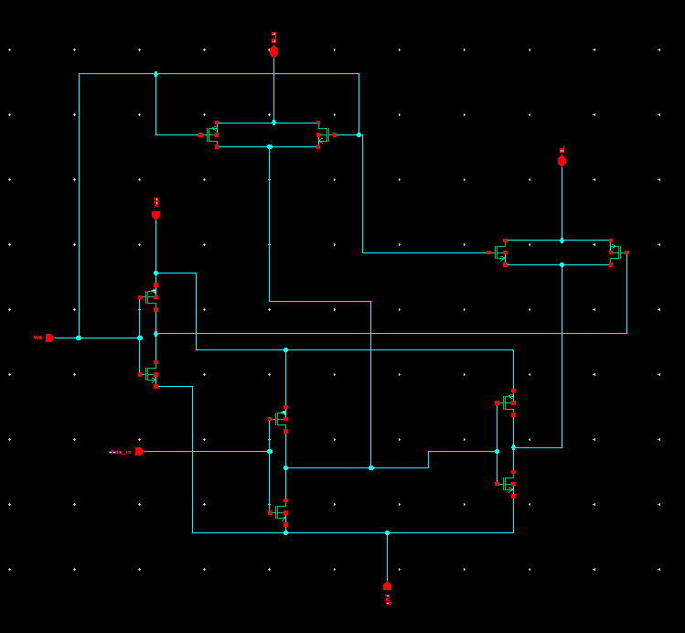
Write Driver
The write driver is used for writing data into the SRAM cell through the access transistors. The write driver will pull one of the bit lines low and the other high depending on the data input. Supposing we have data = 0, then the bit line (BL) is pulled down to GND while the BLB is at VDD. Similarly, if data =1 then one of the bit lines (BL) is pulled to VDD by transistor M3 while the BLB is pulled to GND by the transistor M2
Fig. 29. Write driver schematic
Fig. 30. Write driver symbol

Slide 26
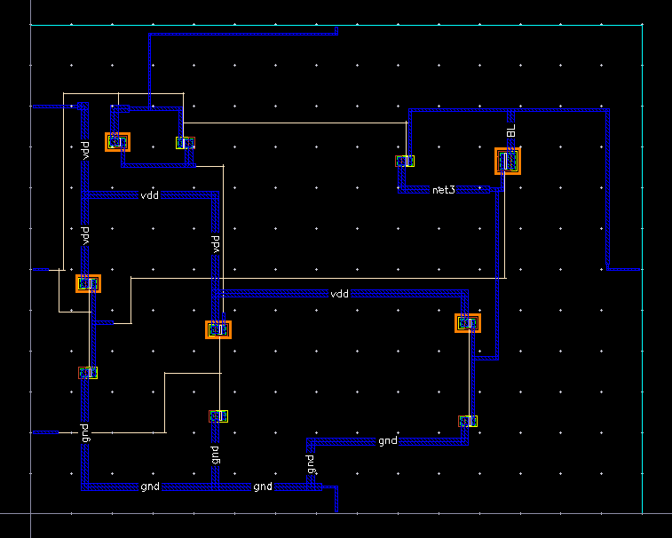
Fig. 31. Write driver layout

Slide 27
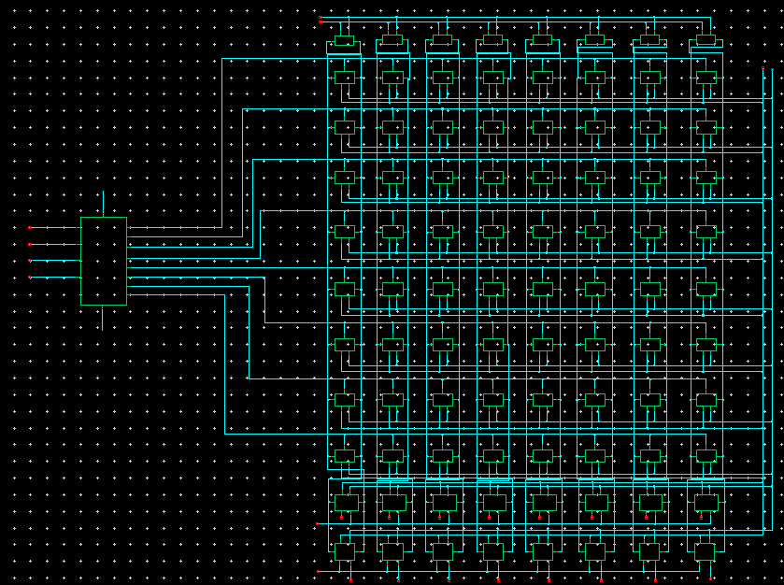
SRAM Architecture
Fig. 32. SRAM whole system architecture

Slide 28
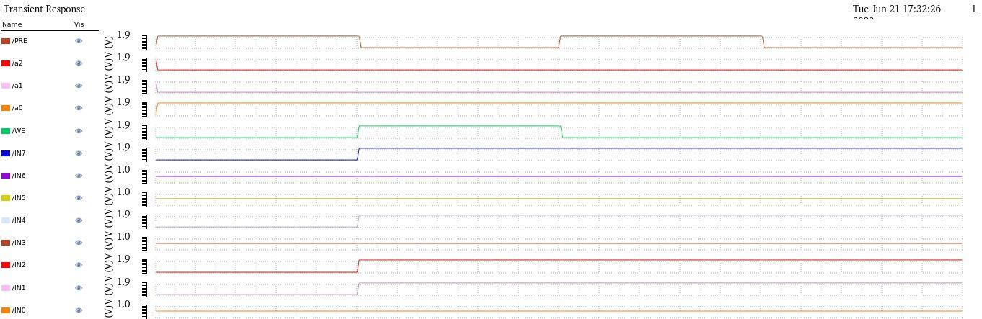
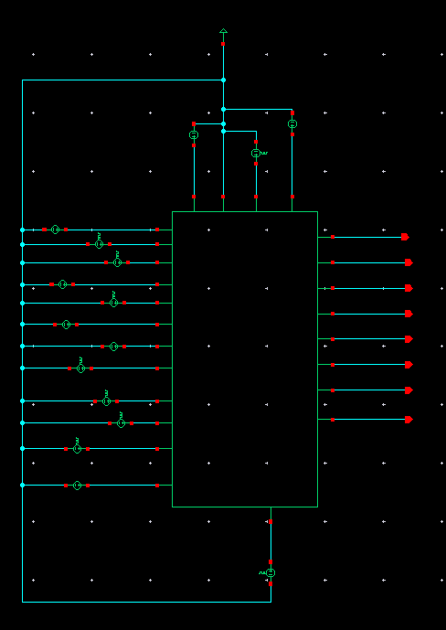
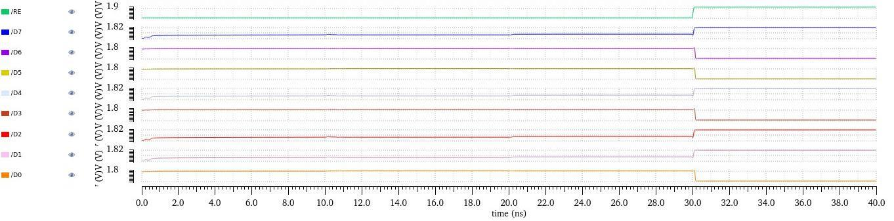


















Fig. 33. Test circuit
Fig. 34. Simulation result

Slide 29
CALCULATIONS
Table 3: Results obtained
Parameters | Results to be obtained from Proposed design
Process Technology | 180nm
Power supply voltage | 1.8v
Pre-charge voltage | 0.9v
Power consumption | 3.14mW
Read Delay | 196ps
Write Delay | 830.5ps

Slide 30
CONCLUSION
In conclusion, the proposed design of an 8x8 bit SRAM array with a row decoder for low power applications demonstrates significant advancements in both performance and power efficiency. Utilizing a 180nm process technology with a power supply voltage of 1.8V and a pre-charge voltage of 0.9V, the design achieves notable reductions in power consumption while maintaining competitive read and write delays. With a power consumption of 3.14mW, read delay of 196ps, and write delay of 830.5ps, the proposed SRAM array showcases its potential for integration into energy-efficient systems where low power consumption is paramount. These results underscore the viability of the design for contemporary applications demanding both performance and power efficiency, positioning it as a promising solution for future low-power embedded systems and IoT devices.

Slide 31
REFERENCES
[1] Ezeogu Chinonso Apollos – “Design Principles of SRAM Memory in Nano-CMOS Technologies”, International Journal of Computer Applications (0975 – 8887) Volume 178 – No. 11, May 2019
[2] Ming-Hwa Sheu , S M Salahuddin Morsalin , Chang-Ming Tsai ,Cheng-Jie Yang, Shih-Chang Hsia , Ya-Hsin Hsueh, Jin-Fa Lin and Chuan-Yu Chang – “Stable Local Bit-Line 6 T SRAM Architecture Design for Low-Voltage Operation and Access Enhancement”, Published: 15 March 2021
[3] Shivani Yadav, Neha Malik, Ashutosh Gupta and Sachin Rajput – “Low Power SRAM Design with Reduced Read/Write Time”, October 2013
[4] L.Saranya, T.S.Divya, R.Manoranjitham, G.Arun kumar, R.Karthick Krishnan – “A Survey on Low Power Comparison in SRAM Cell”, International Journal of Pure and Applied Mathematics Volume 118 No. 20 2018, 611-616

Slide 32
THANK YOU

